Slide 1

Applied Distributed Systems
January 14th, 2020
Suresh Marru, Marlon Pierce
smarru@iu.edu, marpierc@iu.edu

Slide 2
Todays Outline
What To Expect
Course Logistics
Course Topic Overview
Open Discussion

Slide 3
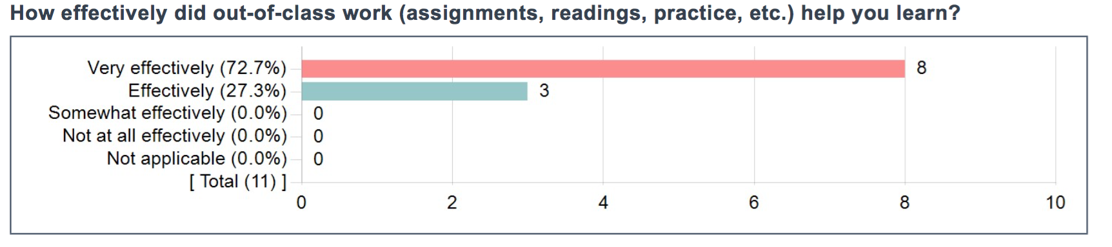
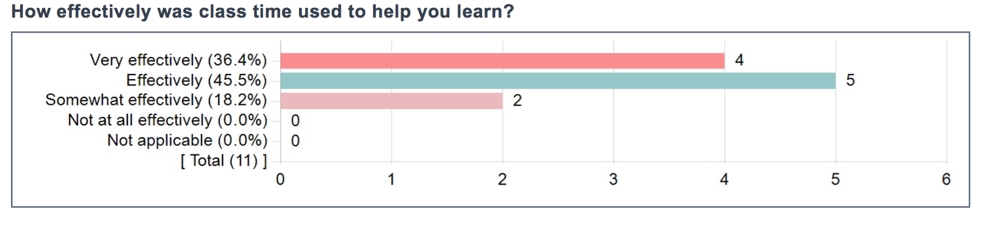

Slide 4
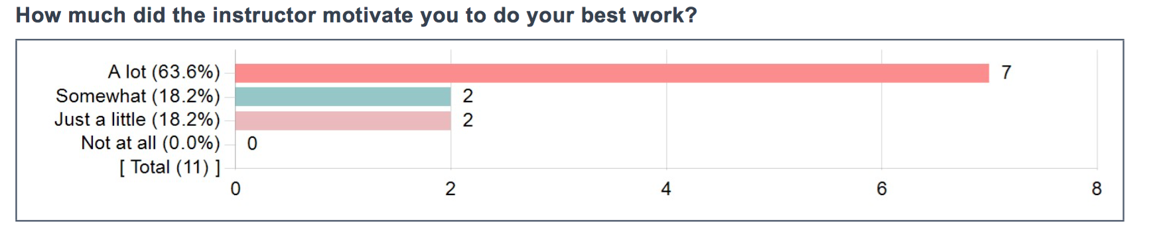
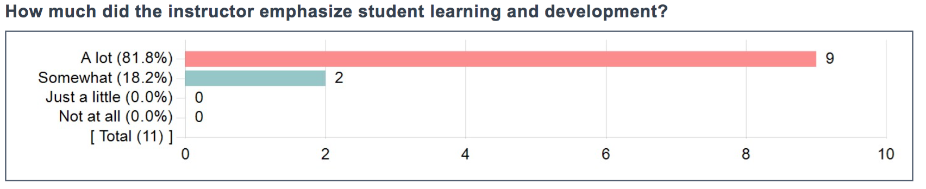

Slide 5
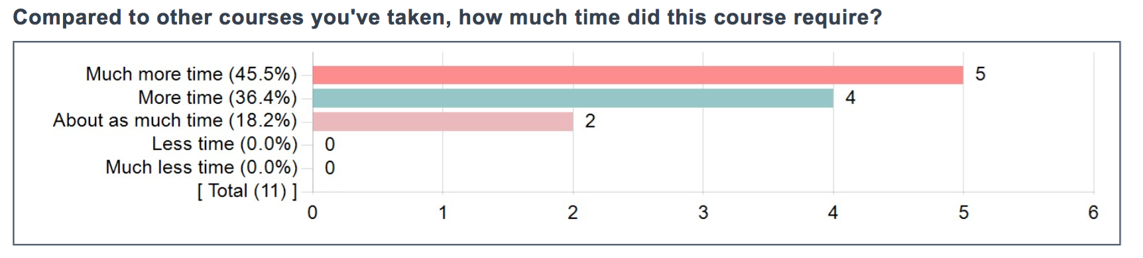
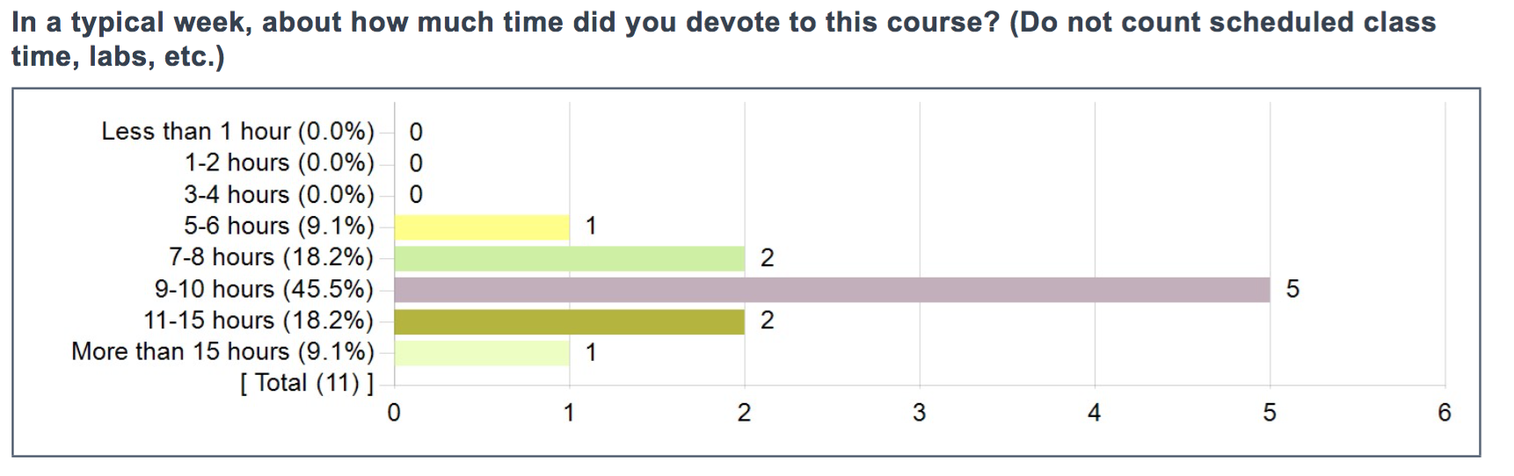

Slide 6
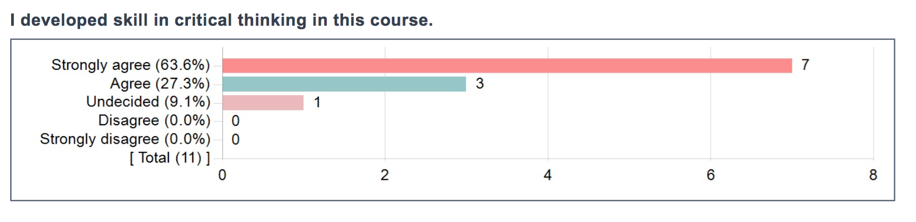
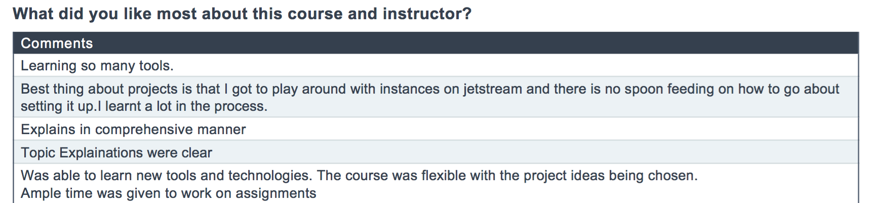

Slide 7
Structure of the Class
We will have 3 project-based assignments
90% of your grade
25 points/project as a team of 3-4
5 points/project for peer review (individual)
The first two assignments will be due before semester break.
Each team will get the same assignment to build a science gateway using distributed systems concepts
The third assignment will be for each team to apply your understanding to open problems in Apache Airavata.
10% of your grade will be attendance and classroom interactions.

Slide 8
Class Format
We will do a mixture of traditional lectures, interactive lectures, and flipped classrooms.
Lectures will alternate between technology overviews and core concepts
“What is Kubernetes and how do you use it?”
“What are the architectural choices for building distributed systems?”
We’ll also set aside “hackathon” time occasionally as we get near assignment deadlines.

Slide 9
Sources of Truth
Refer to the course’s Canvas site for the authoritative information on deadlines, assignment details, assignment points, and grades.
You will submit all assignments through Canvas.
You can get lecture slides from https://courses.airavata.org
All your work will go into GitHub.
Your code, your issues, your documentation, your peer reviews

Slide 10
Should You Take This Class?
We expect you to do a lot of work for the class
We only require you to be able to write code and have a basic understanding of network protocols like HTTP and TCP/IP.
We expect you will find the class challenging, rewarding, and enjoyable
Make your semester plans accordingly
We’ll offer the class again in Spring 2021

Slide 11
Applied Distributed Systems
We will build user-centric distributed systems that support scientific research.
Science gateways
Cyberinfrastructure
This course will be project-based.
You will build distributed systems.

Slide 12

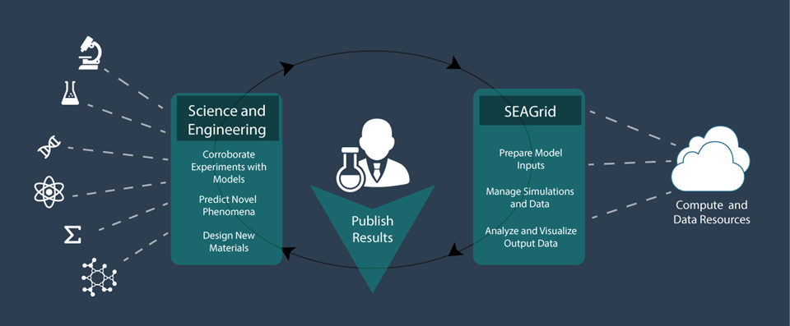
SEAGrid.org is an Apache Airavata-powered gateway

Slide 13
Hydrated Calcium Carbonate in Action

Slide 14
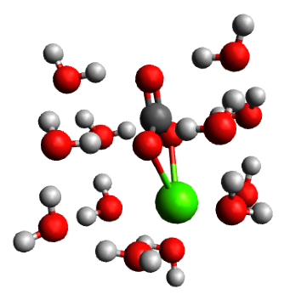
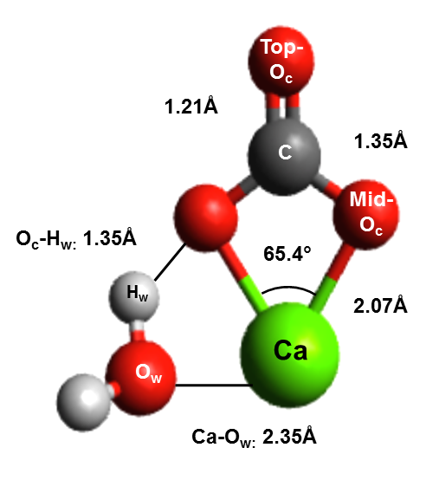
What is the chemistry of hydrated calcium carbonate?
Bio-mineralization of skeletons and shells
Geological C02 sequestration
Cleanup of contaminated environments
Lopez-Berganza, et al. J Phys. Chem. A(2015)
CaCO3.1H2O
CaCO3.12H2O
Notes:
If we go back to the earliest stages, during the ion pair formation, it is believed that the hydration shell around these minerals can dictate which pathway to is followed. Of course, study of hydration shell is challenging in the lab, so we rely on computational chemistry. For this particular study, we focused on thoroughly characterizing the hydration shell of calcium carbonate at different hydration levels. We hydrated a single molecule. We work with static structures. One of the practical challenges of this is how do we place water molecules to find the equilibrium states?
Biomineralization is a process by which minerals from nature are incorporated into biological systems for a variety of functions. Calcium carbonate is an abundant mineral extracted from calcium and carbonate ions in solution and used by many organisms to support critical functions such as structural entities such as skeletal systems and functional entities as protective layers. A specific aspect of self-healing of these tissues is interesting and should be applicable in engineered processes. In this study, we attempt to provide the thermodynamics of hydration of the mineral calcium carbonate in terms of the water coordination and ionic interactions. Ab initio quantum chemical simulations of large hydrated calcium carbonate clusters are challenging due to the existence of multiple local energy minima. SEAGrid Science Gateway and the applications deployed and provided to the community were used for this project for preprocessing, computations and post processing work.
Extensive conformational searches around hydrated calcium carbonate clusters (CaCO3·n H2 O for n = 1− 18) were performed to find low-energy hydration structures using an efficient combination of Monte Carlo searches, density-functional tight binding (DFTB +) method, and density-functional theory (DFT) at the B3LYP level, or Møller−Plesset perturbation theory at the MP2 level. This multilevel optimization yields several low-energy structures for hydrated calcium carbonate. Structural and energetics analysis of the hydration of these clusters revealed a first hydration shell composed of 12 water molecules. Bond-length and charge densities were also determined for different cluster sizes. The solvation of calcium carbonate in bulk water was investigated by placing the explicitly solvated CaCO3·n H2 O clusters in a polarizable continuum model (PCM) of water. The findings of this study provide new insights into the energetics and structure of hydrated calcium carbonate and contribute to the understanding of mechanisms where calcium carbonate formation or dissolution is of relevance.

Slide 15

CaCO₃.xH₂O Initial guess
SEAGrid.org enabled workflow
Stampede2 Supercomputer
TINKER
Monte Carlo Molecular Mechanics
(Minimize Torsional Energy in <20,000 steps)
Stampede2 Supercomputer
DFTB+
Approximate DFT-Based
x=x+1
-2-3 CaCO3 Equilibrium Structures
-Thermochemistry (E,H,G, etc.)
-Vibrational Frequencies
Comet Supercomputer
Gaussian09
Ab initio Quantum Chemistry
Lopez-Berganza, et al. J Phys. Chem. A(2015)
Notes:
Our approach uses a combination of MM to identify low energy candidates(which avoids any water placement bias). These candidates were then further optimized with more rigorous methods(DFTB+ and Gaussian 09). This approach gave us not only equilibrium structures, but also the thermochemistry of the clusters.

Slide 16
Browser
HTTPS
Web Interface Server
Client SDK
HTTP or TCP/IP
Server SDK
Application Server
Resource Plugins
IU: Big Red 3
XSEDE: Stampede2
XSEDE: Comet
Juelich: Jureca

Slide 17
Challenges for Science Gateways
Providing a rich user experience
Defining an API for the application server
Defining the right sub-components for the application server.
Implementing the components, wiring them together correctly.
Supporting multiple gateway tenants
Fault tolerance for components
State management (“transactions”)
Continuous integration and deployment
Security management

Slide 18
Goal 1: Apply basic distributed computing concepts to Science Gateways.

Slide 19

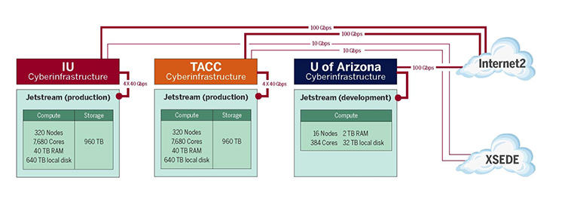
Science Engineering Cloud based on OpenStack

Slide 20
Goal 2: Apply new architectures, methodologies, and technologies to Science Gateways: Microservices, DevOps

Slide 21
Goal 3: Teach open source software practices

Slide 22
Why Do We Teach This Class?
We are looking for students who like what we do and want to contribute to Apache Airavata.
Technologies change, and we need to keep up ourselves.

Slide 23

What Is Apache Airavata?
Open source middleware to support Science Gateways
Compose, manage, execute, and monitor distributed, computational workflows
Wrap legacy command line scientific applications with Web services.
Run jobs on computational resources ranging from local resources to computational grids and clouds
Record, preserve, search, and share metadata about computational experiments
Hosted version of Apache Airavata provides multi-tenanted Platform as a Service.
SciGaP

Slide 24
The Changing Way for Developing and Delivering Software
Microservices vs Monolithic Applications

Slide 25
Monolithic Applications: Traditional Software Releases
Software runs on clients’ systems
Software releases may be frequent, but they are still distinct
Firefox
OS system upgrades
Traditional release cycles
Extensive testing
Alpha, beta, release candidates, and full releases
Extensive recompiling and testing required after code changes
Code changes require the entire release cycle to be repeated

Slide 26
Microservices: Software as a Service
Does your software run as an online service?
Traditional release cycles don’t work well
May make releases many times per day
Test-release-deploy takes too long
You can be a little more tolerant of bugs discovered after release if you can fix quickly or roll back quickly.
Get new features and improvements into production quickly.

Slide 27
What Is a Microservice?
Develop a single application as a suite of small services
Each service runs in its own process
Services communicate with lightweight mechanisms
“Often an HTTP resource API”
But that has some problems
Messaging and hybrid approaches
Independently deployable by fully automated deployment machinery.
Minimum of centralized management of these services,
May be written in different programming languages
May use different data storage technologies.
http://martinfowler.com/articles/microservices.html

Slide 28
Recall the Gateway Octopus Diagram
Browser
HTTPS
Web Interface Server
Client SDK
HTTP or TCP/IP
We will focus on this piece
Server SDK
Application Server
Resource Plugins
Karst: MOAB/Torque
Stampede: SLURM
Comet: SLURM
Jureca:SLURM

Slide 29
Basic Components of the Gateway App Server
API Server
Server SDK
Application Server
Application Manager
Metadata Server
Resource Plugins

Slide 30
Decoupling the App Server
API Server
Application Manager
Metadata Server
API Server
API Server
API Server
API Server
Application Manager
Metadata Server
Application Manager
Metadata Server
Application Manager
Metadata Server
Application Manager
Metadata Server
Application Manager
Metadata Server
Application Manager
Metadata Server

Slide 31
How Do We Package and Where Do We Run All Those MicroServices?
On the Cloud? In the Matrix?

Slide 32
Virtualization, Containers, Docker

Slide 33
How Do Microservices Communicate?
Push, Pull e.t.c

Slide 34
Messaging Systems: RabbitMQ, Apache Kafka

Slide 35
How Can Components Expose their APIs and Data Models to Other Components?
And can we make this programming language independent?

Slide 36
API and Metadata Model Design

Slide 37
How Can I Discover, Monitor, and Manage Services?
Can we learn some lessons from distributed systems research?

Slide 38
Distributed State Management: Consul, ETCD, Zookeeper

Slide 39
How Do I Manage Logs from Microservices
And detect if there are problems

Slide 41
How Can I Secure Microservices?
How do I manage user identities, authentication and authorization?

Slide 42
Security: OAuth2 and OpenIDConnect

Slide 43
How Can We Automate All of This?
How can we make our infrastructure reproducible?

Slide 45
Next Lecture
More details about the first two project assignments
Recap for any new students
Bring your questions

